Slide 1
Paraview

Slide 2
Outline
Good practices
Specific tips for nice images

Slide 3
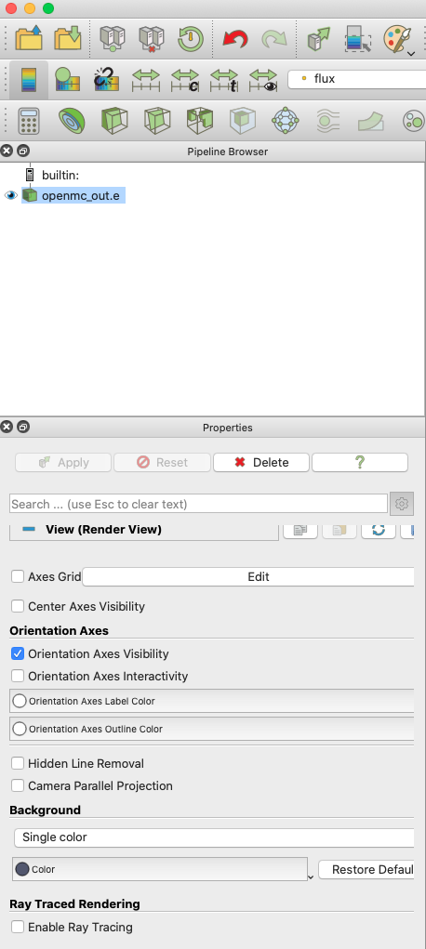
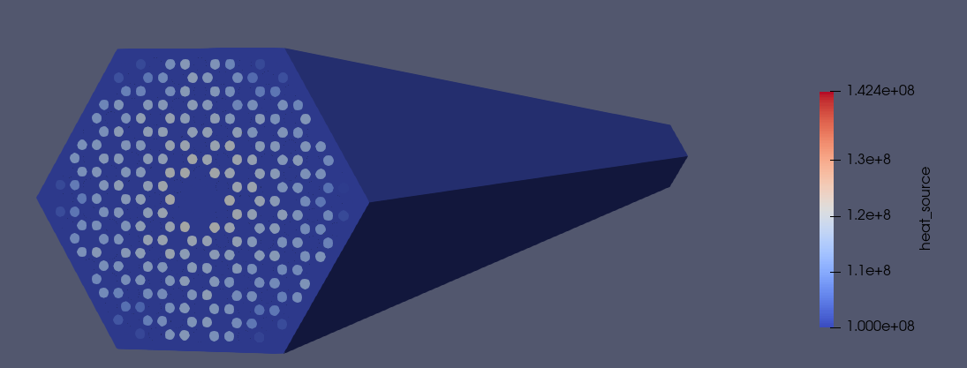
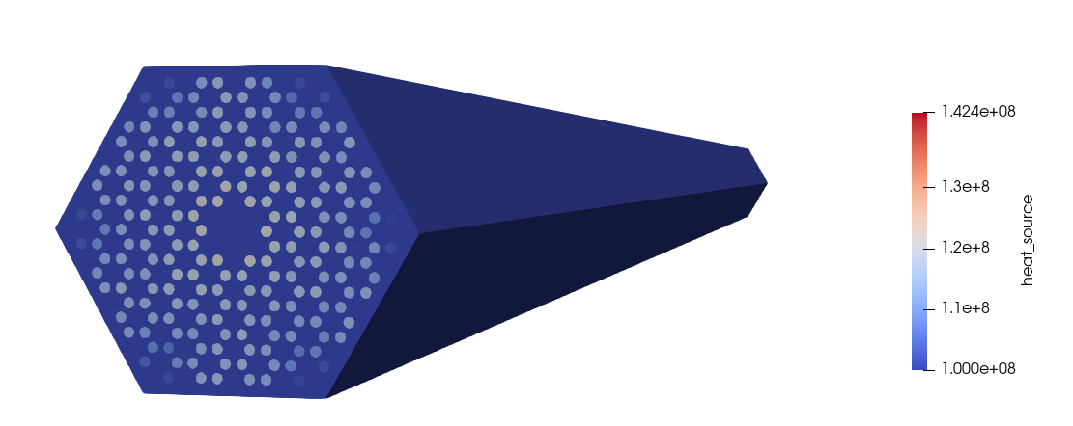
White Background
Always turn the background to white before taking any images

Slide 4
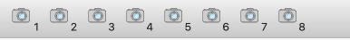
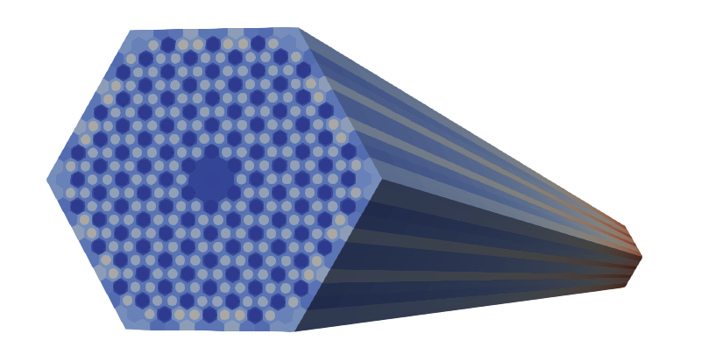
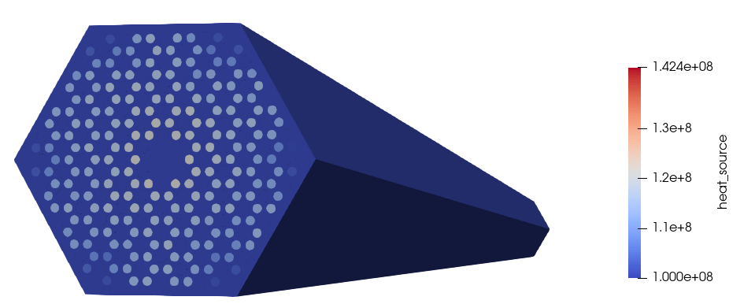
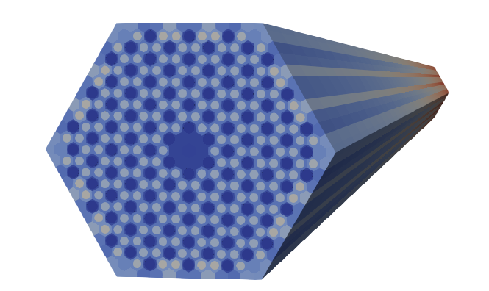
Saving a View “Position”
If you’re generating multiple figures over the same geometry, it’s good to show them all from the same perspective
Fig 1. Here is my data; showing in the same perspective looks more professional.

Slide 5
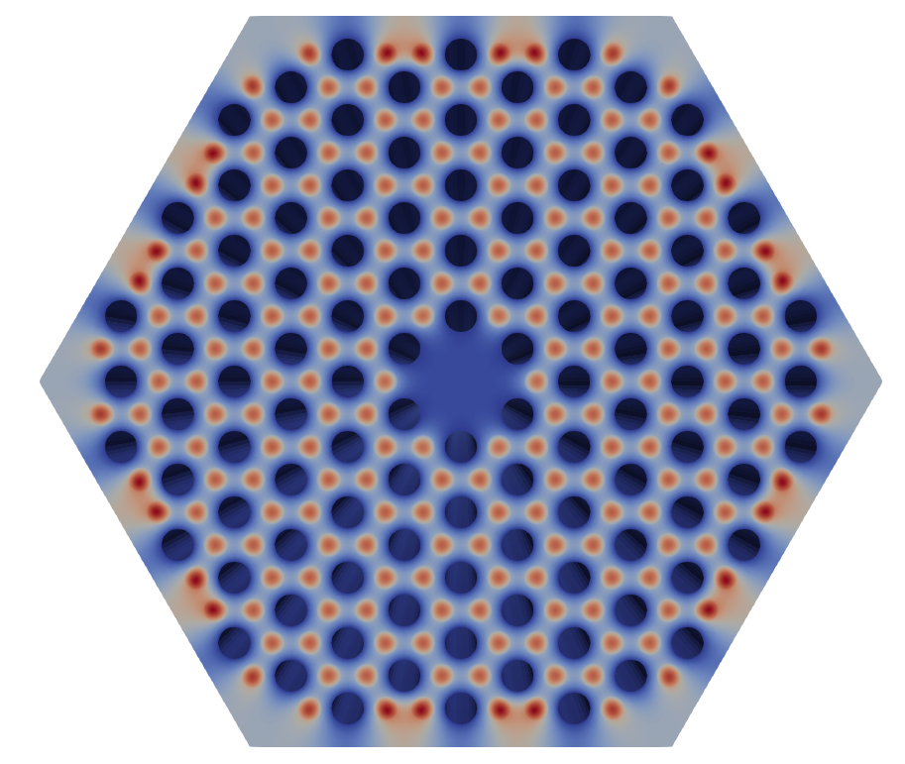
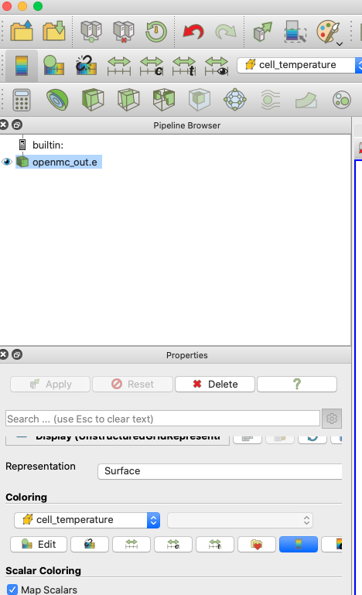
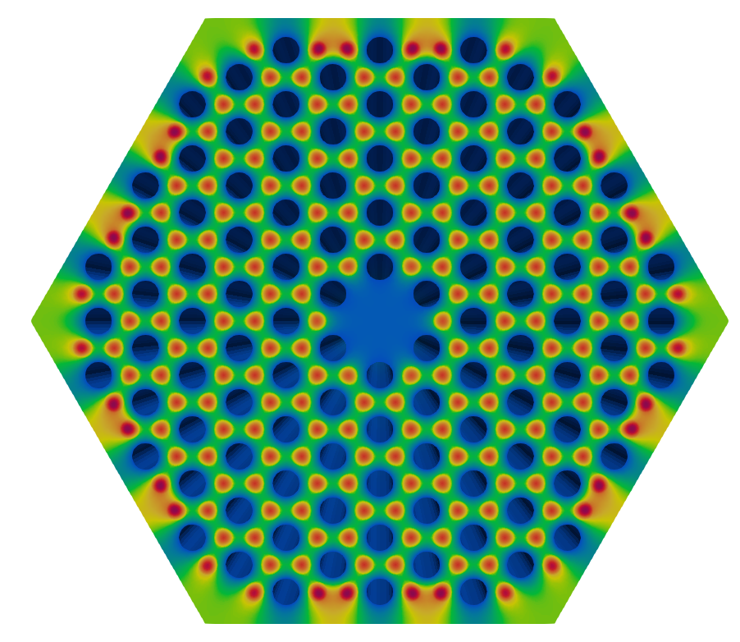
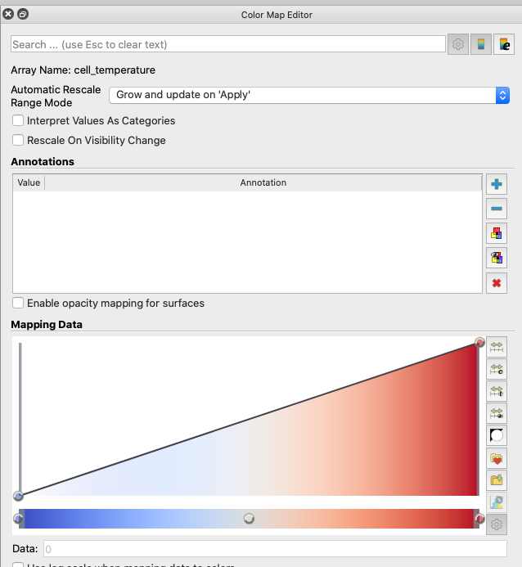
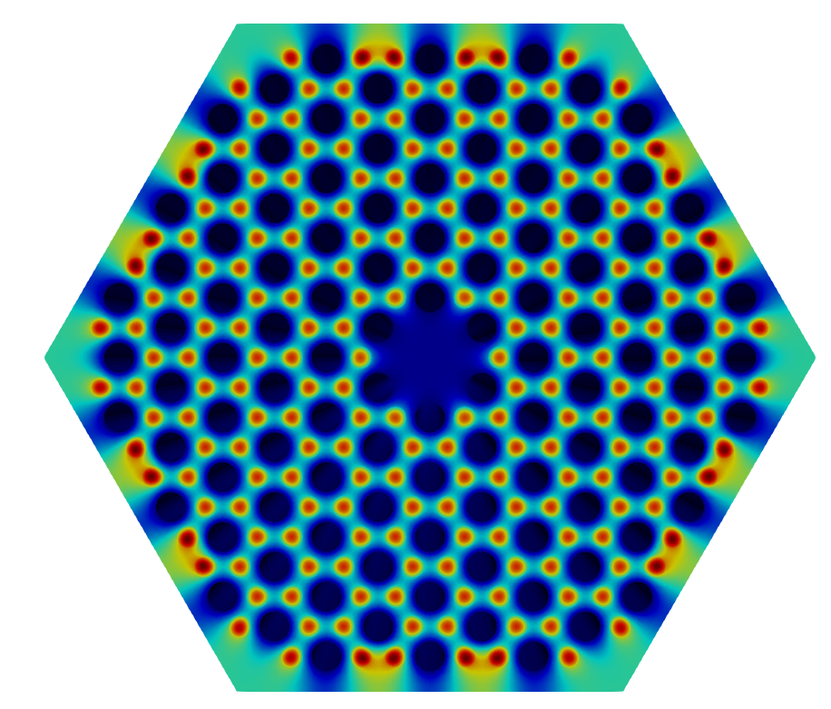
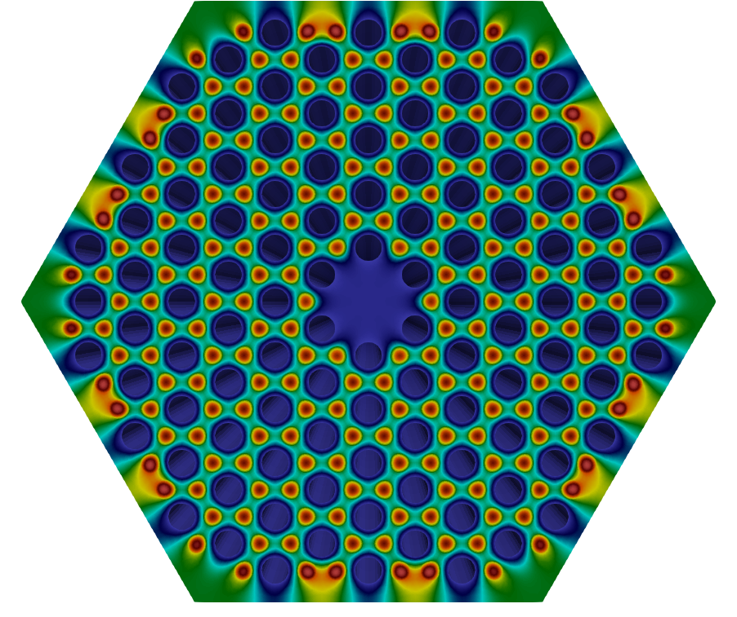
Probably Don’t Use Default Color Scale

Slide 6
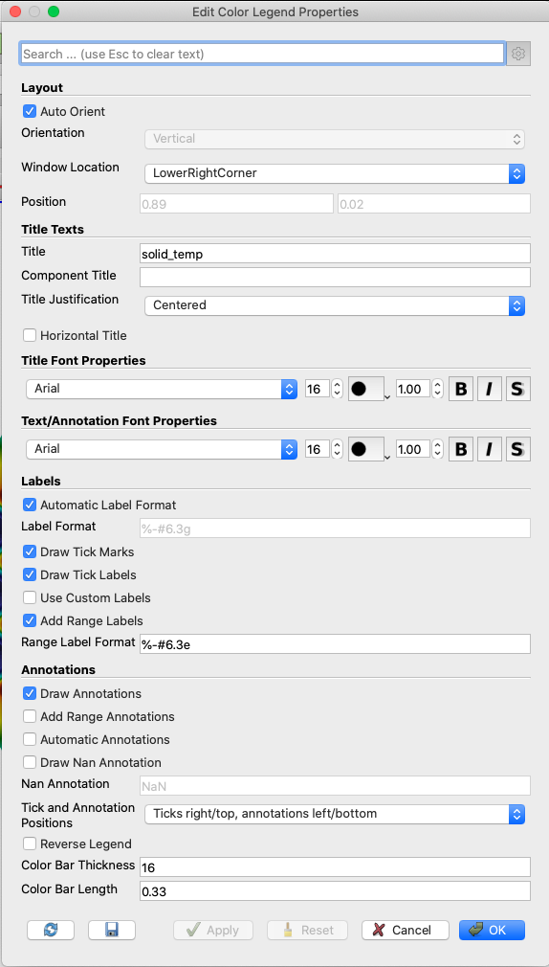
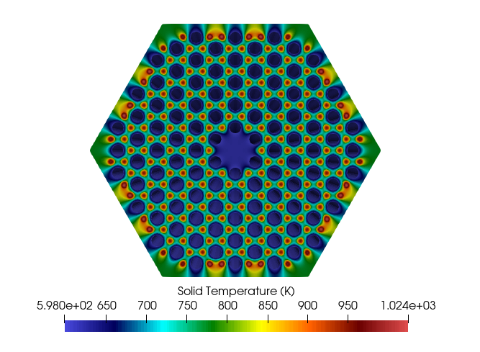
Make Pretty Legends
How to make the legend horizontal
How to change the label
Definitely rewrite the variable name if it has underscore/etc.
Good to add units directly on the legend
Horizontal legends sometimes look nice

Slide 7
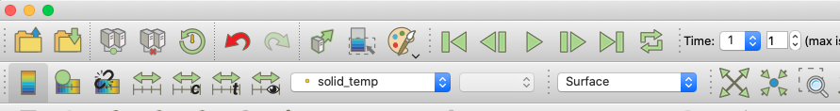
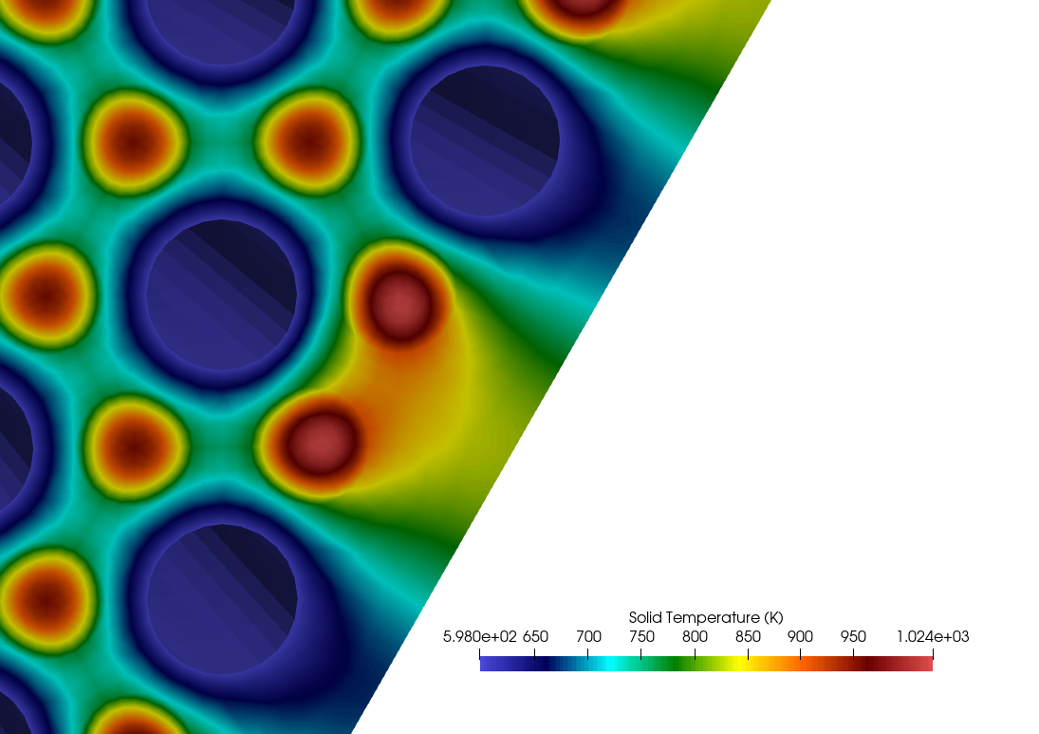
Zoom Into Features

Slide 8
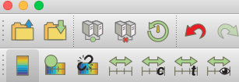
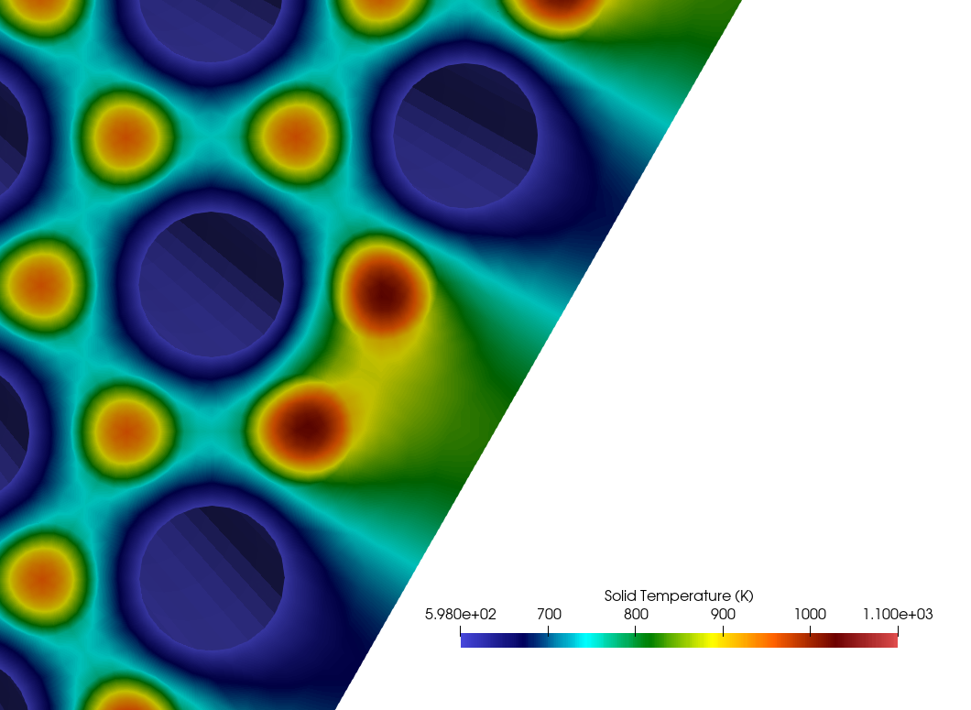
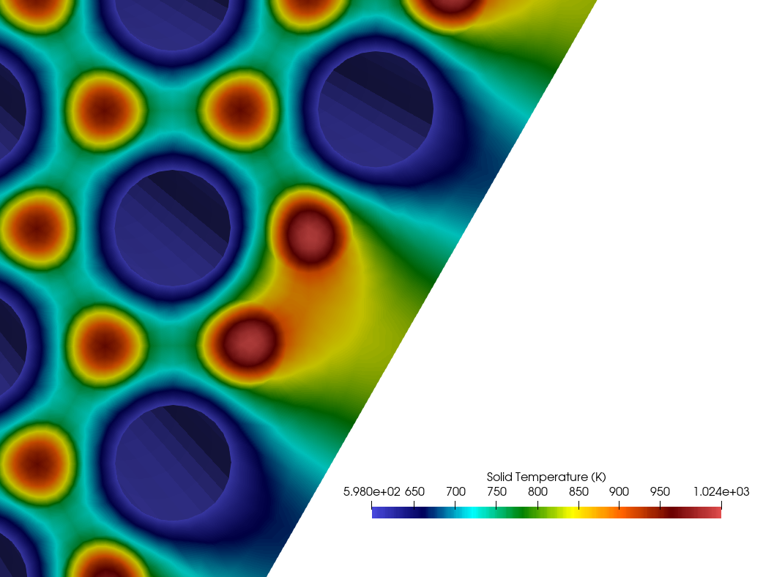
Always Scale Data to Visible Range
People will always assume the max/min on your color scale is the max/min of your data
BAD: The maximum temperature is NOT 1100 K.

Slide 9
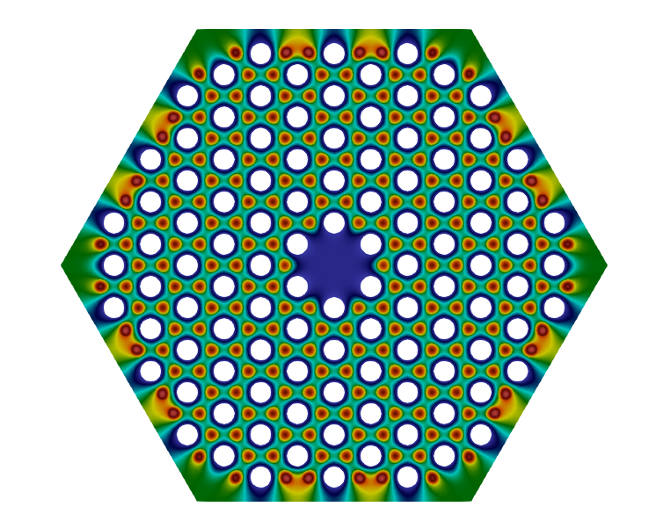
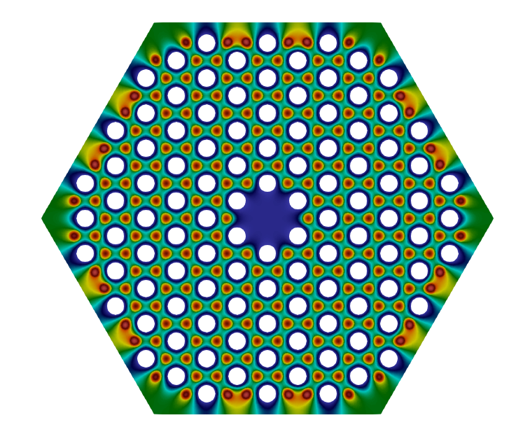
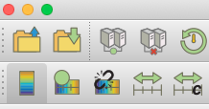
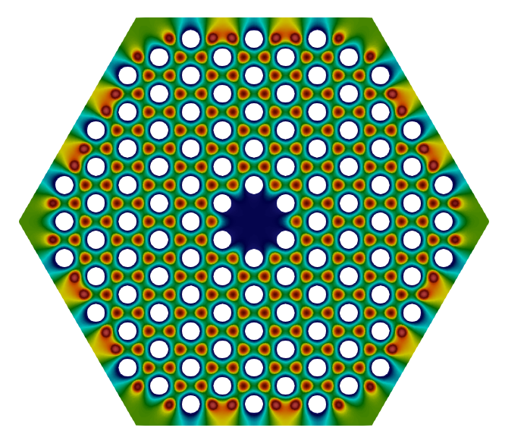
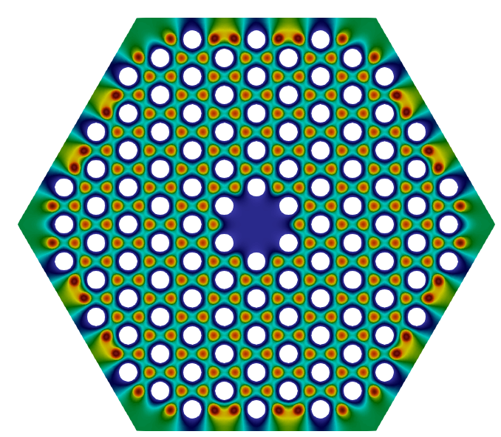
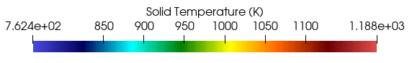
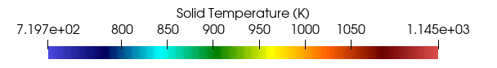
Use Consistent Legend Scales
If you show the same data on side-by-side plots, use the same legend color bounds: easier to compare data
Fig 1. Here is my data for two different simulations. They show different simulations, but it’s impossible to tell HOW if the color scales aren’t different!
Fig 2. Here is my data for two different simulations. They are shown on the same color scale, so it’s easier to compare side-by-side.

Slide 10
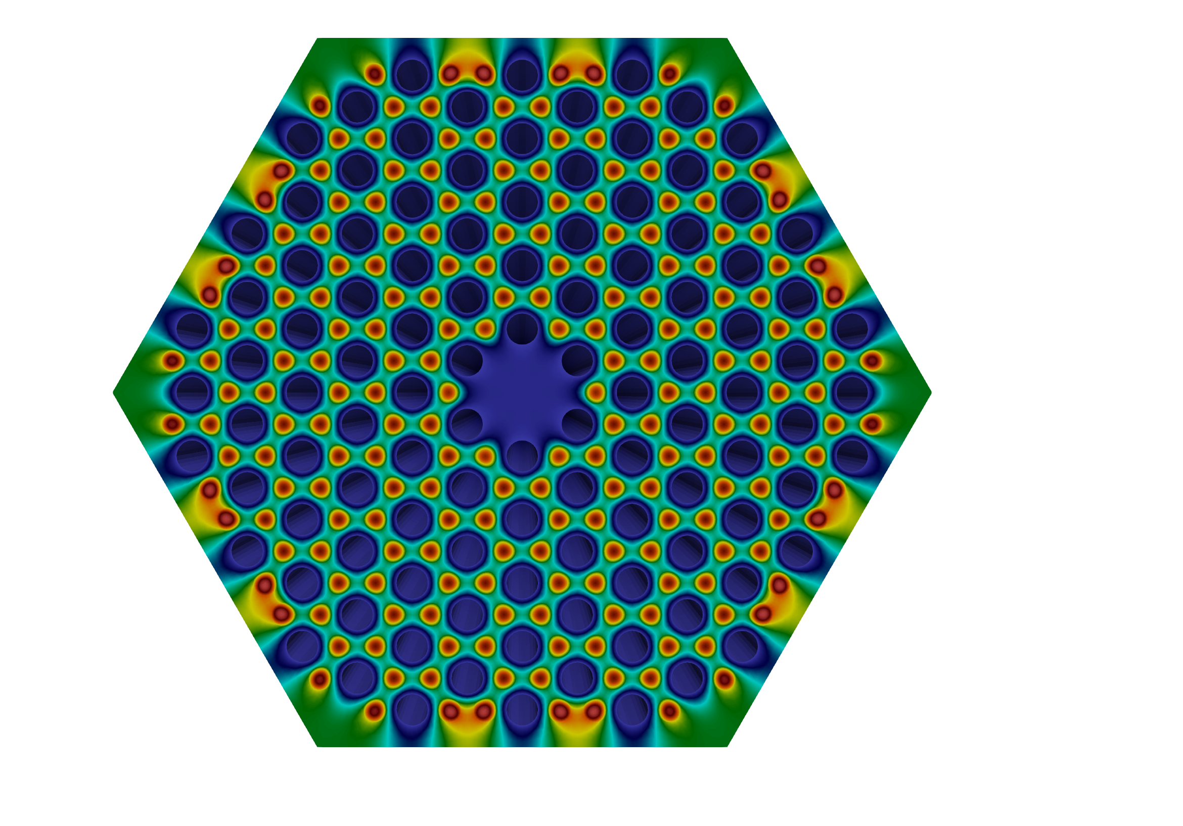
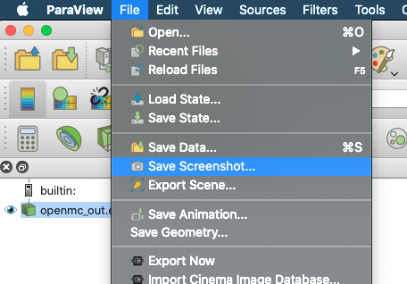
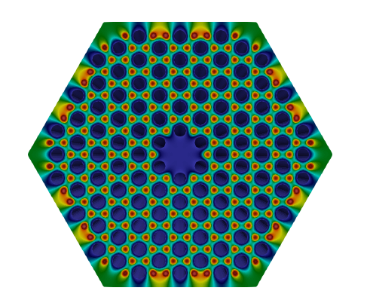
Take screenshots with Paraview
BAD: Screenshots with your keyboard/mouse can be low resolution

Slide 11
General Ideas
Think about what data you want to show
Then, think about how to make it look interesting

Slide 12
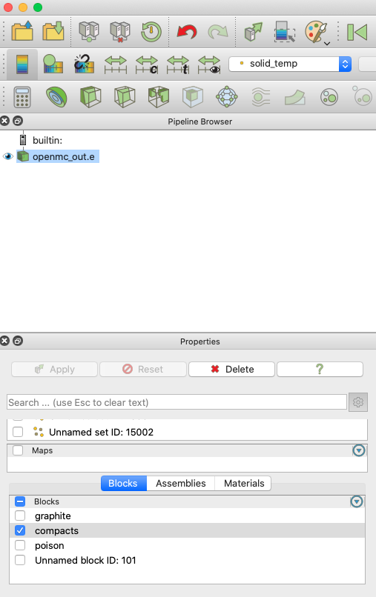
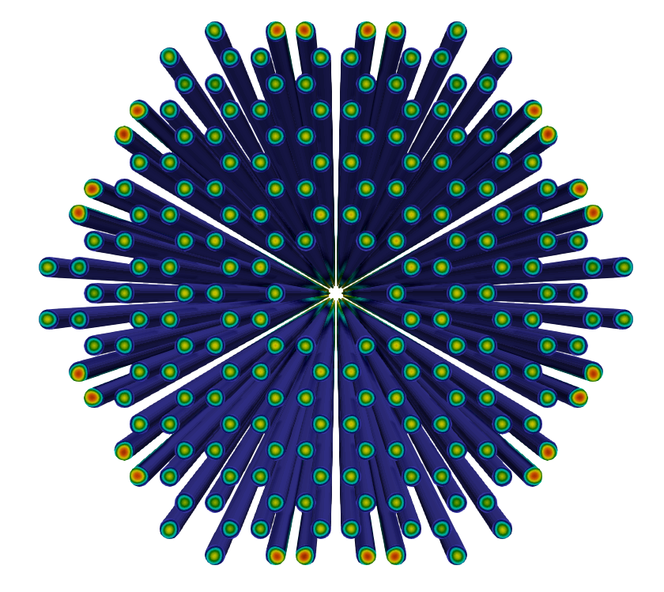
Select Only Some Blocks
Use to hide extraneous regions or focus attention

Slide 13
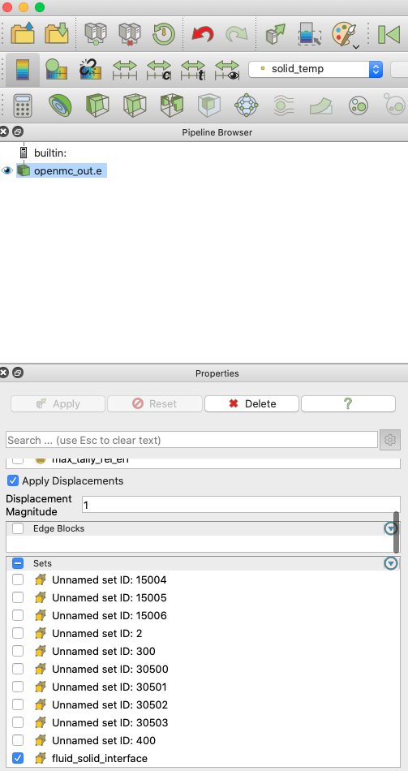
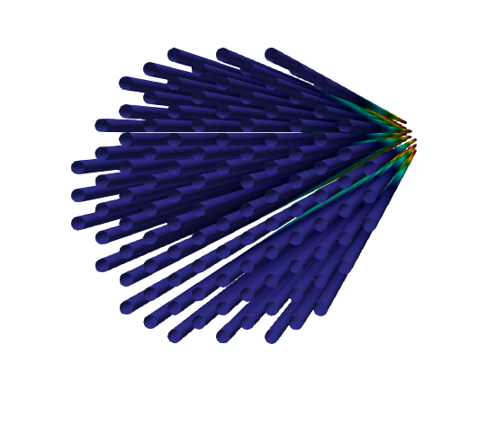
Select Only Some Sidesets

Slide 14
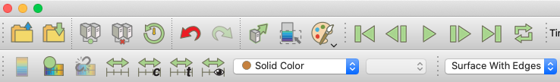
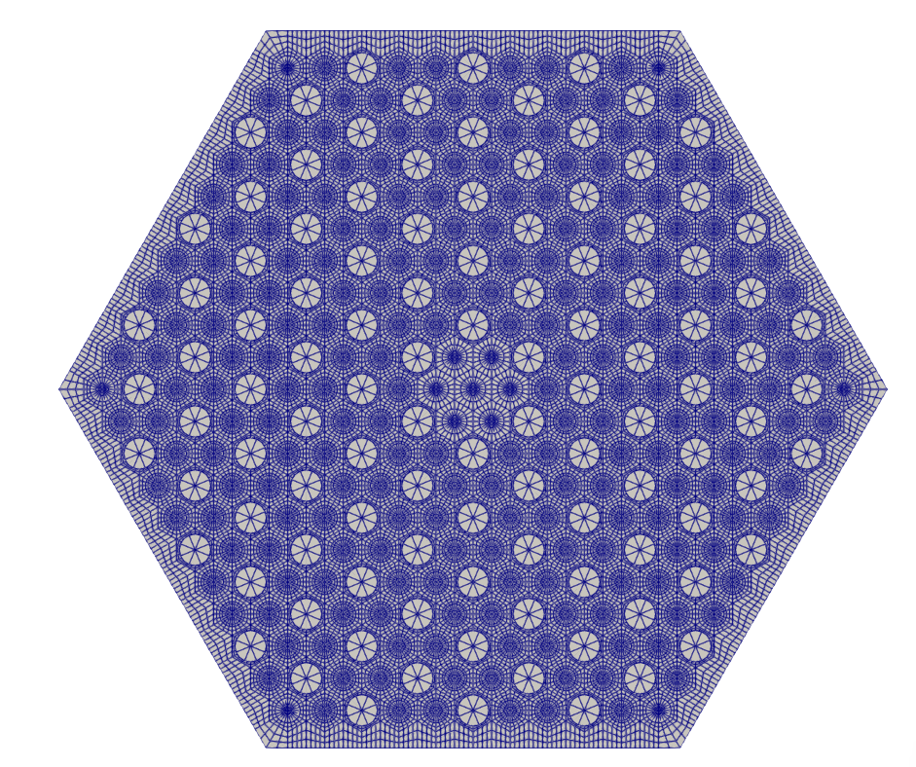
Showing the Mesh

Slide 15
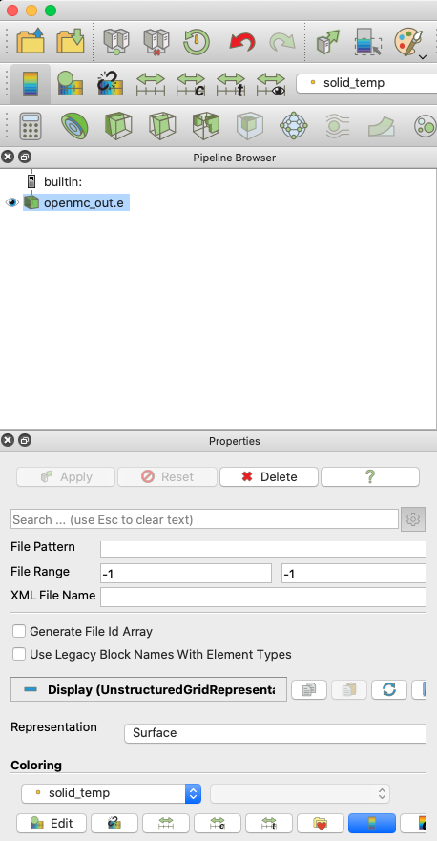
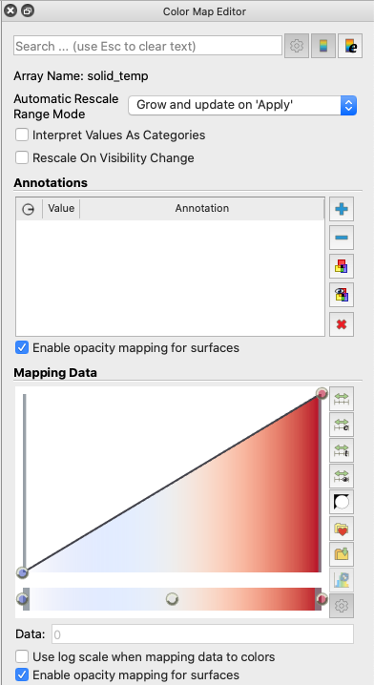
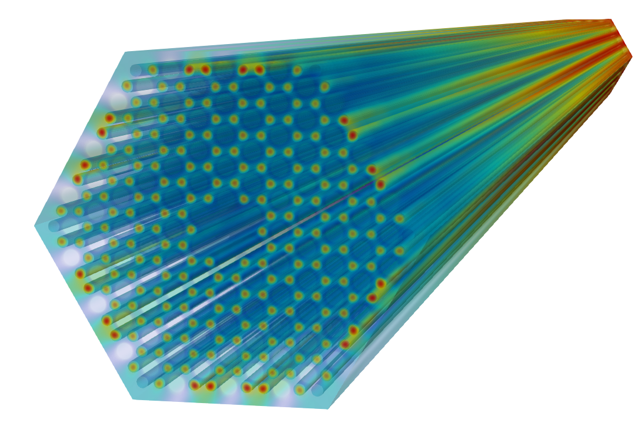
Opacity Mapping
Makes a “see-through” color rendering

Slide 16
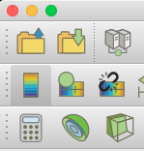
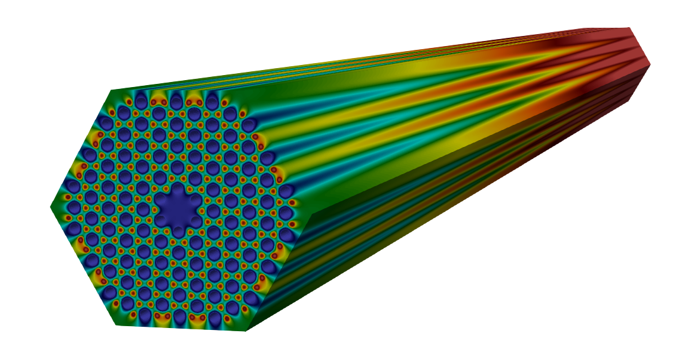
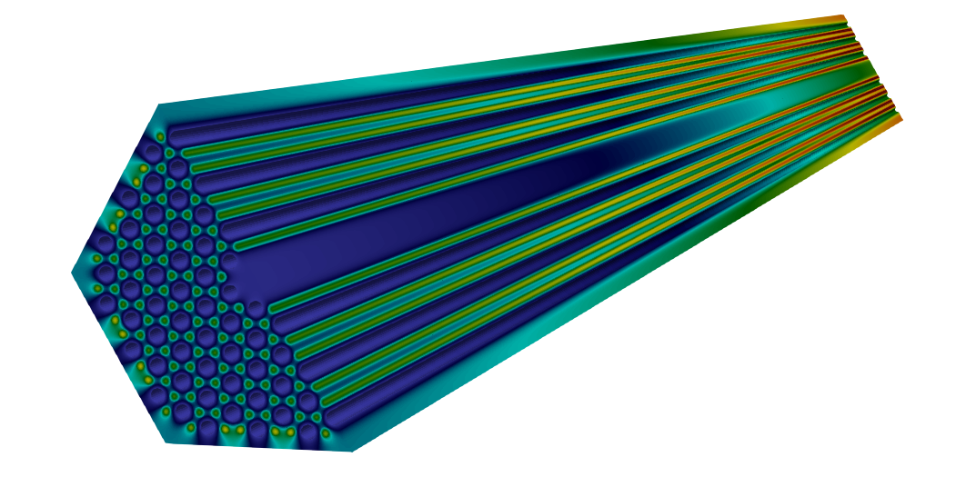
Volume Slices
Slice the geometry along a plane (you specify the unit normal of the plane)

Slide 17
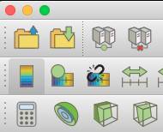
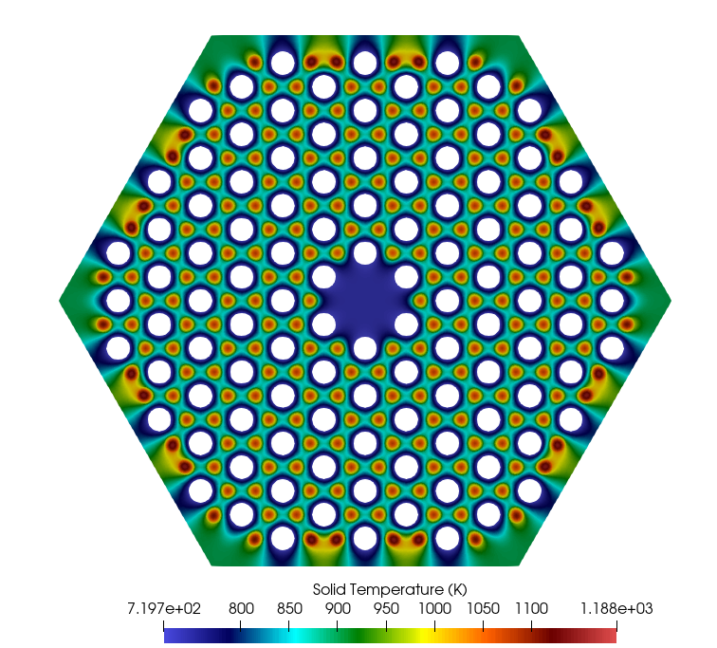
Plane Slices
Slice the geometry at a plane

Slide 18
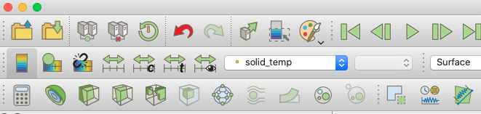
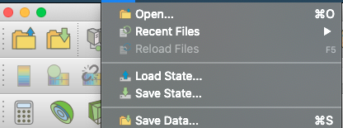
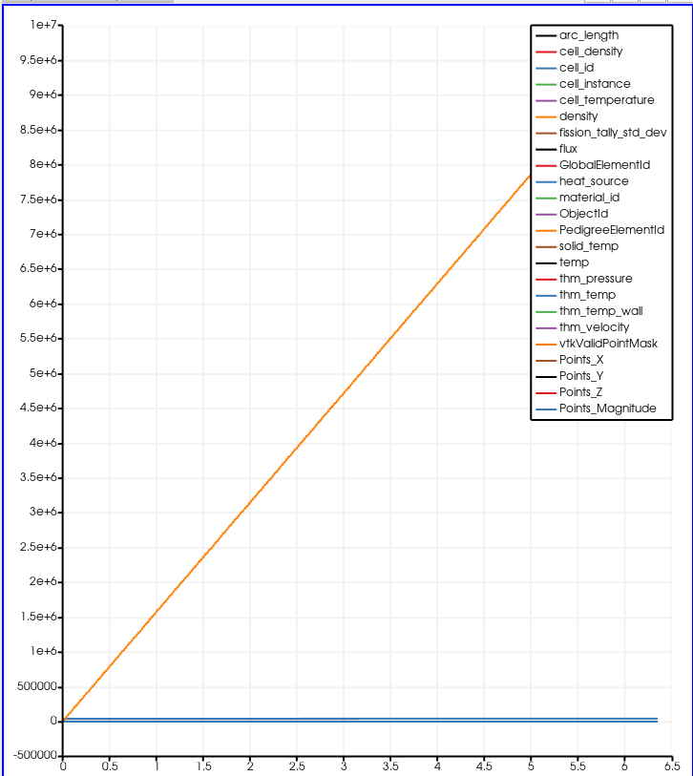
Line Plots
Plot along lines
Save data to CSV and postprocess with Python
Ugly Paraview plot. Do not take screenshots of this.

Slide 19
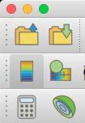
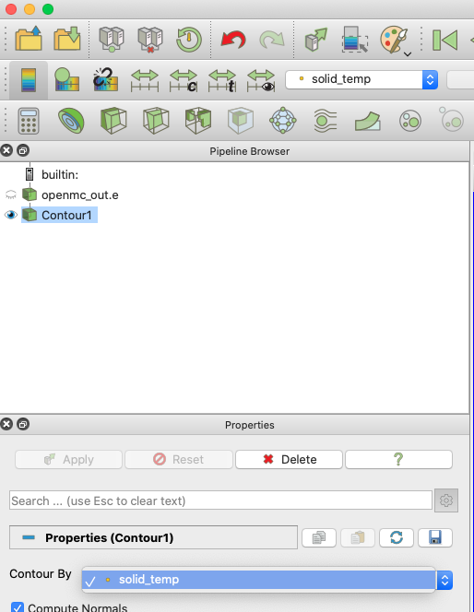
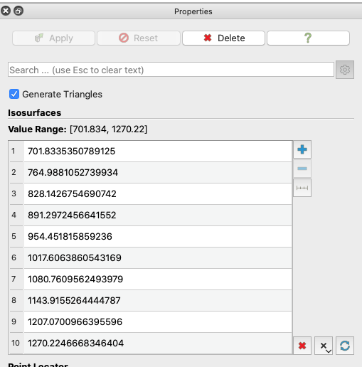
Contours
3. Select new bin indices.
1. Pick what variable you want to contour.
2. Clear out the default bin indices.

Slide 20


Contours

Slide 21
Advanced
Try to make your pictures as interesting as possible
Can I make the results more intuitive for the viewer?
Can I show the same data in multiple formats at once?
Can I overlay the mesh in some regions to combine multiple plots together?
Can I reinforce the geometry that the viewer is looking at? Can I color some region in gray to provide extra context?

Slide 22


Multiple Views of Same Data
You can add arbitrary numbers of “manipulations” of the same data file and view them simultaneously
Re-click on the parent file before adding a new slice/contour/etc.
The eyeball shows us that we are viewing the data.

Slide 23


Open the same file multiple times
Can be used to show totally different fields/views
Suppose I want to look at the tubes to provide some context.

Slide 24


Manipulate the same file multiple ways

Slide 25

Show multiple variables at once
Use different color scales (show both legends) to help explain related data
Tubes are on a separate color scale than the slices.
Tubes show the fluid wall temperature.
Slices show the solid temperature.

Slide 26


Overlay Contours

Slide 27



Show Mesh in Half the Domain
Mesh will look weird if you just slice through it randomly
“Crinkle slice” will show 1 element height
I made Slice 3 and Slice 5 identical; then I did a volume cut through Slice 5 to only show half

Slide 28



Show deformed geometry
For thermomechanics simulations, it is useful to view exaggerated displacements in Paraview.
Use the Warp By Vector feature in Paraview.
Use Warp By Vector feature to show the deformed geometry and select a scale factor to show the exaggerated displacements.
Deformed geometry with a scale factor of 1000 for the displacements.

Slide 29
Powerpoint Tips
Sometimes, taking screenshots in Paraview isn’t enough
Powerpoint can be very powerful for adding extra descriptions/context

Slide 30

Powerpoint: Subtracting images

Slide 31
Powerpoint: Subtracting images

Slide 32

Powerpoint: Use Arrows to show how different views relate

Slide 33
Homework
Make me a picture that combines multiple layers of the same file

